Slide 1
Topic 2-Extension

Slide 2
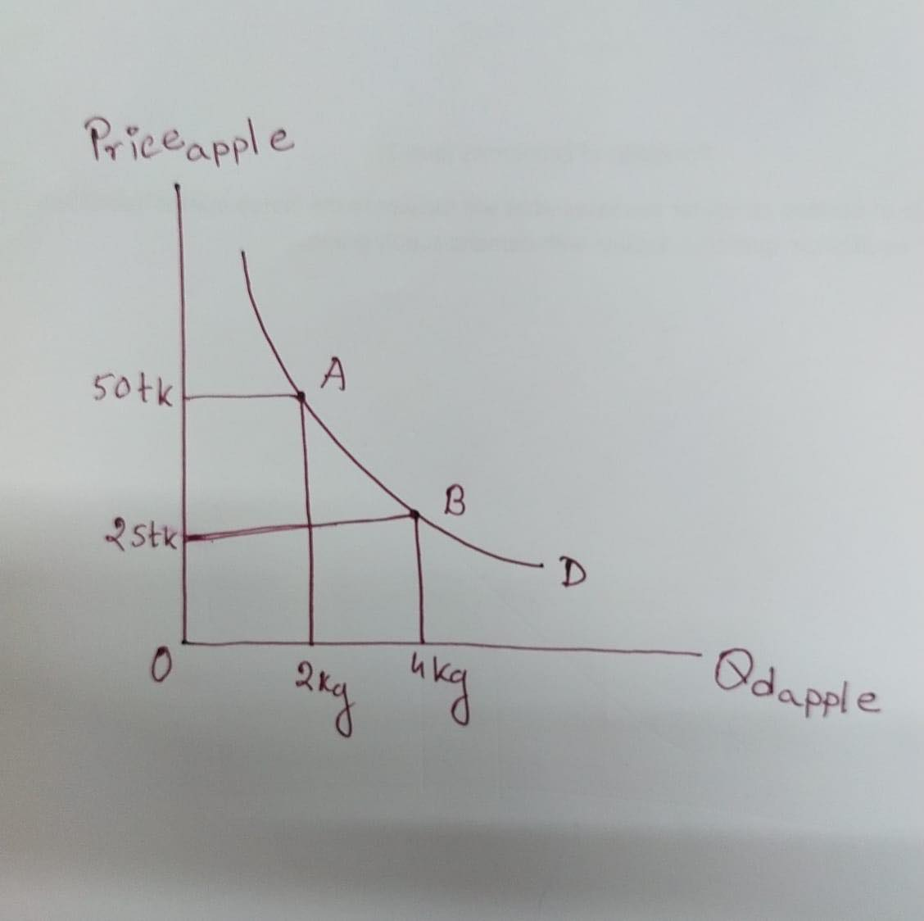
Movement along the demand curve

Slide 3
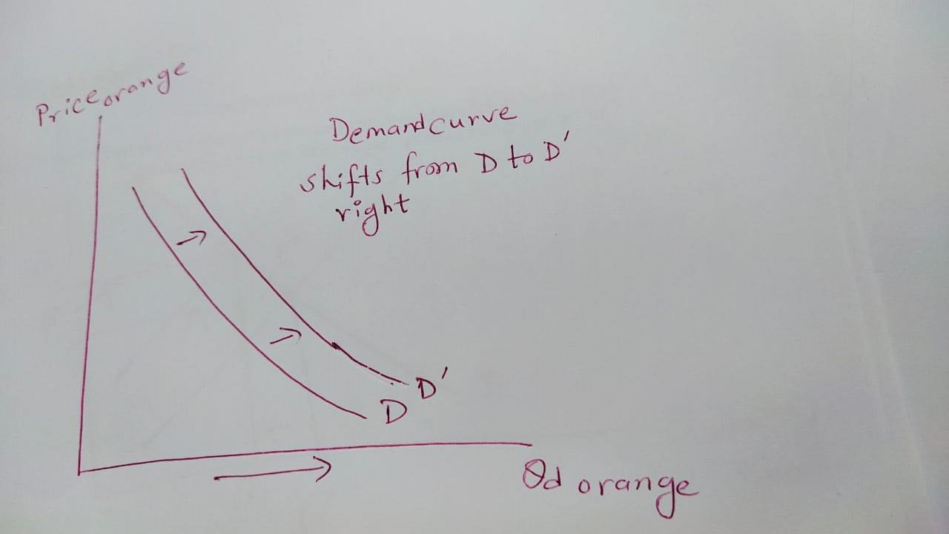
Shift of demand: If income increases and orange is normal good

Slide 4
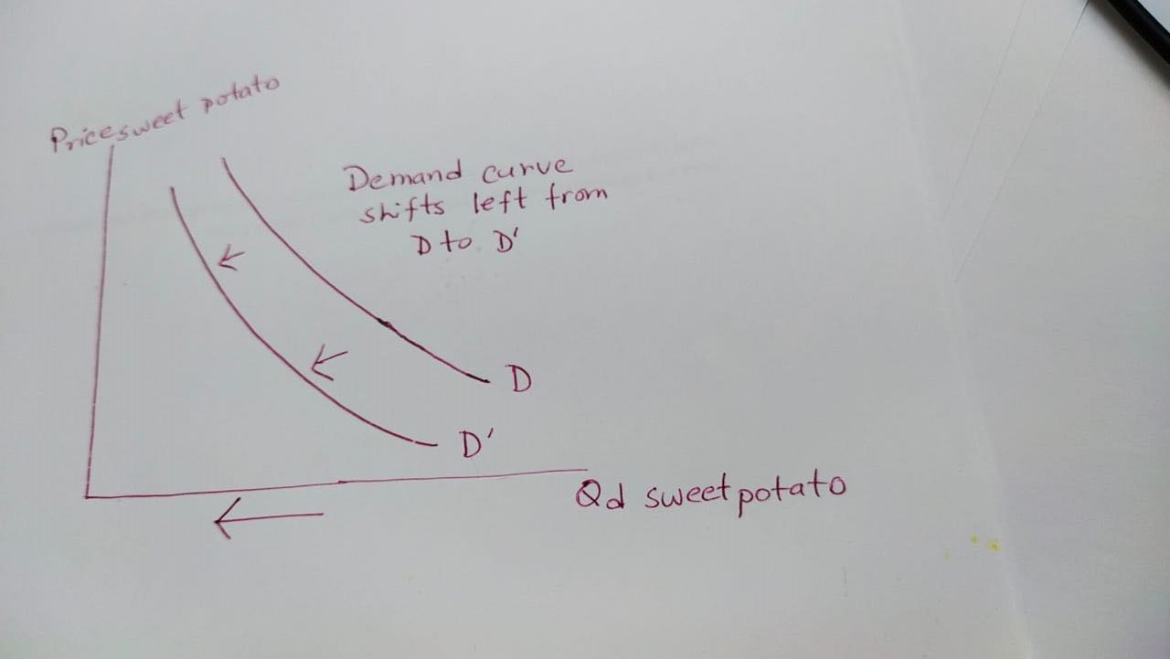
Shift of demand: If income increases and sweet potato is inferior good

Slide 5
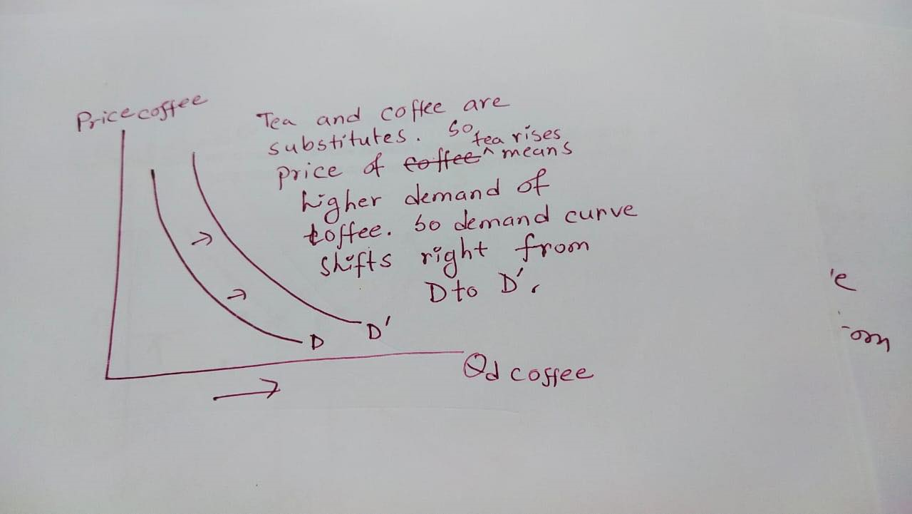
Shift of demand: Price of tea increases and demand for coffee in coffee market

Slide 6
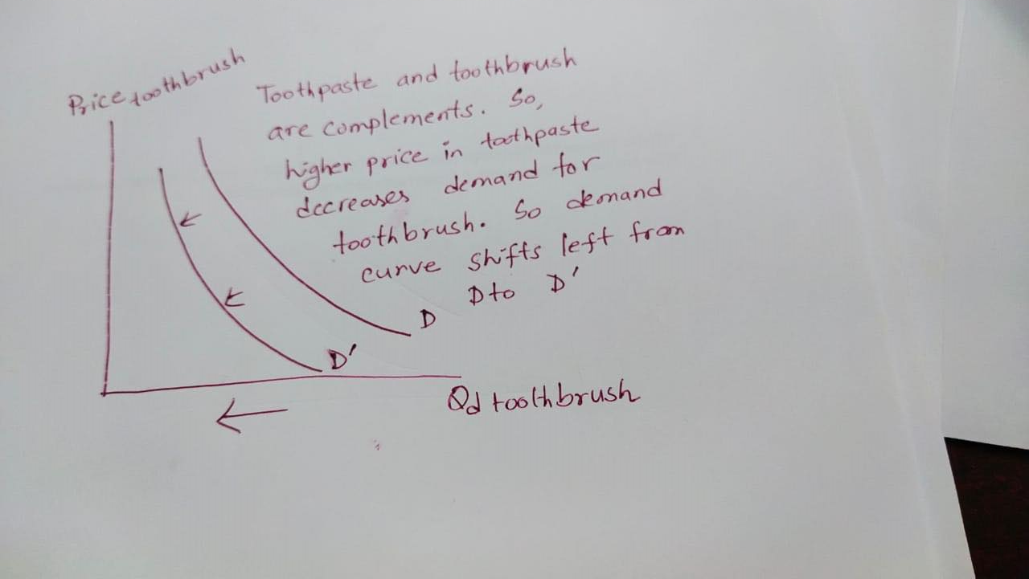
Shift of demand: Price of toothpaste increases and demand for toothbrush in toothbrush market

Slide 7
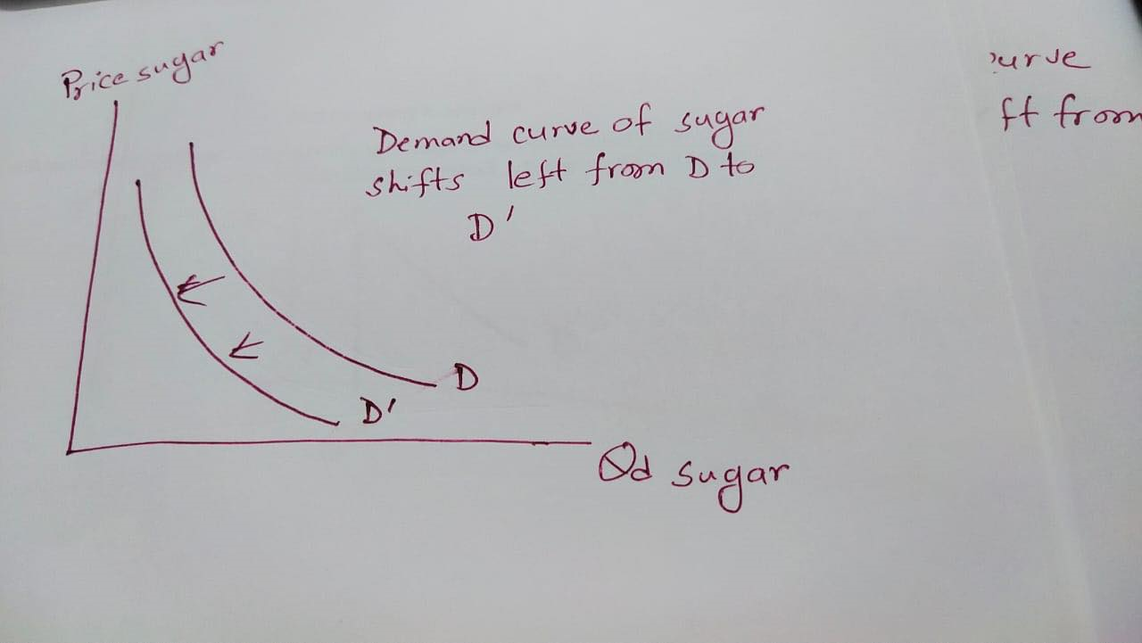
Shift of demand: If people prefers salty food and demand for sugar in sugar market

Slide 8
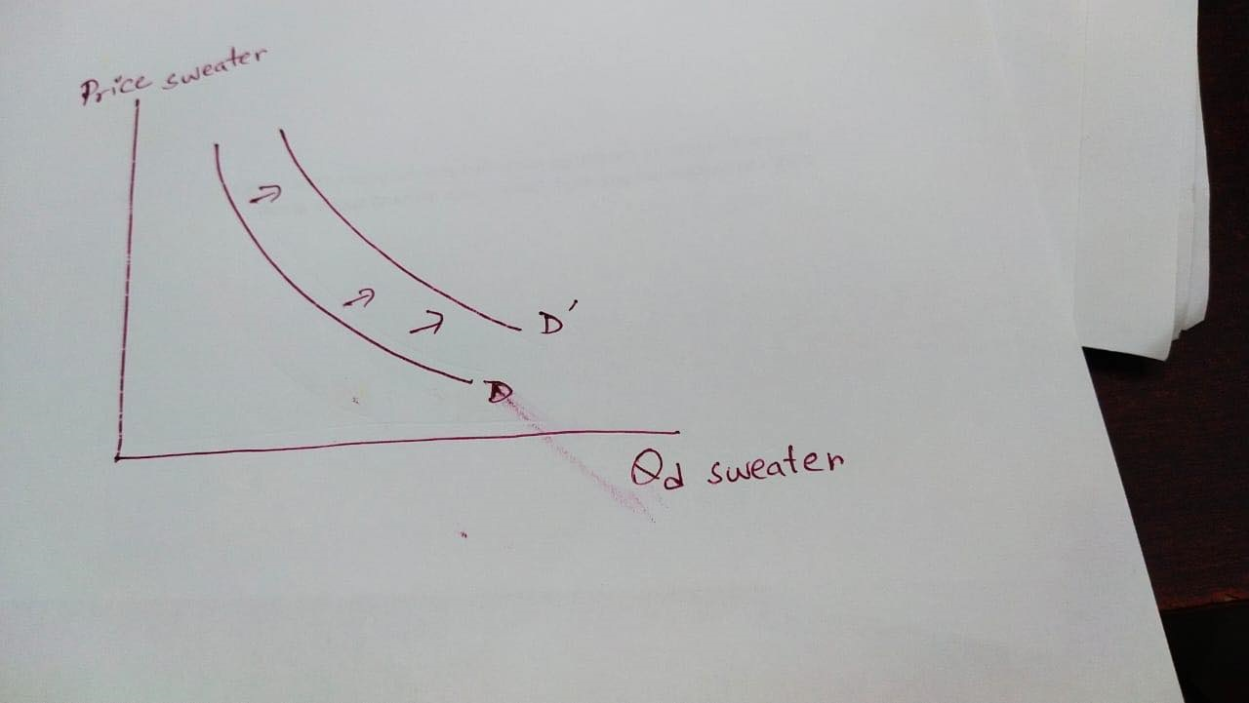
Shift of demand: Next month is December and buyers expect higher price of sweater in December. What will happen to current demand for sweater market?

Slide 9
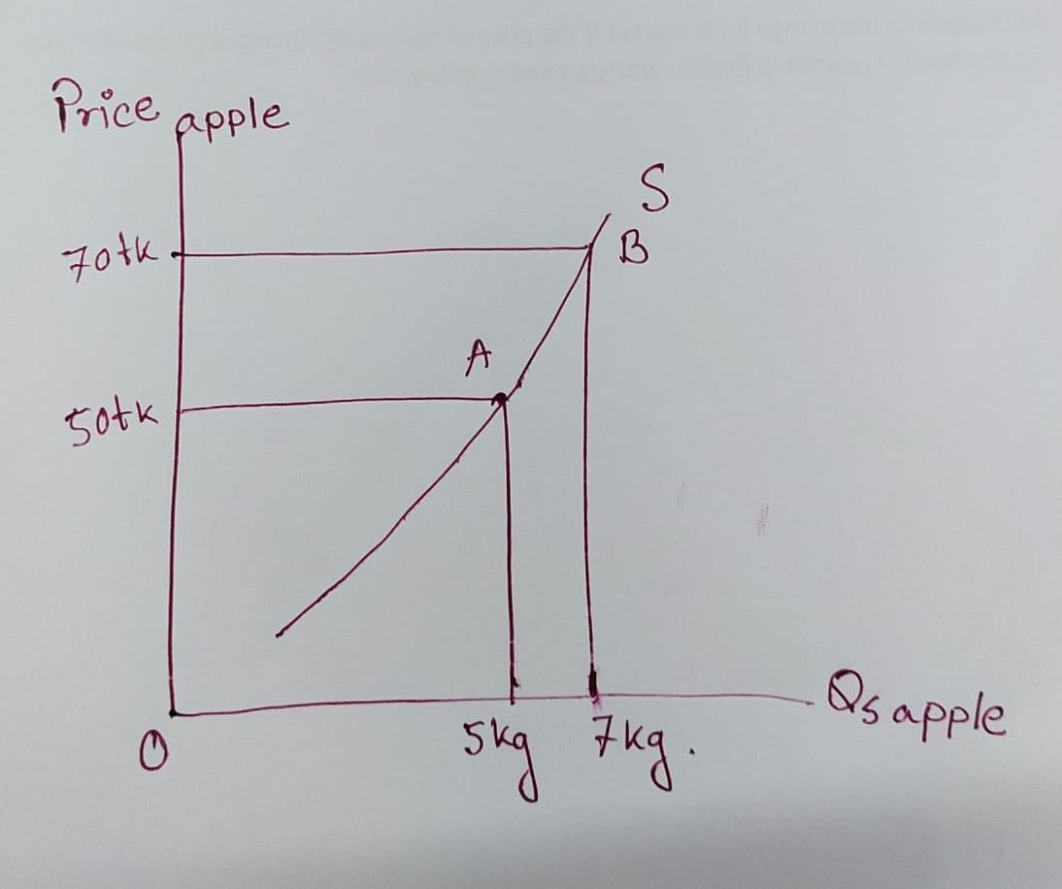
Movement along the supply curve

Slide 10
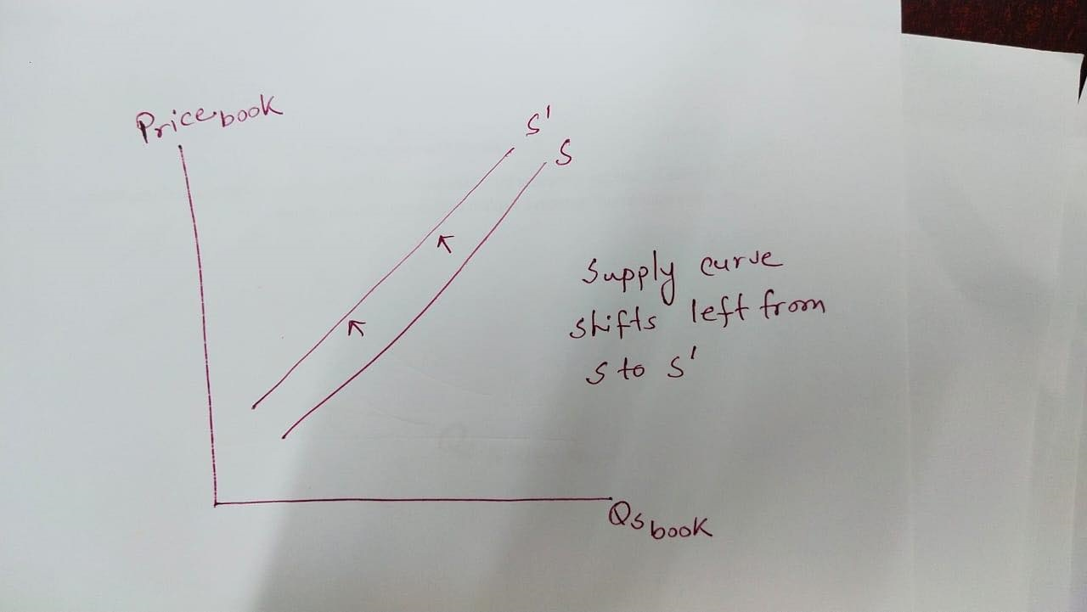
Shift of supply: Price of paper increases and supply of book in book market

Slide 11
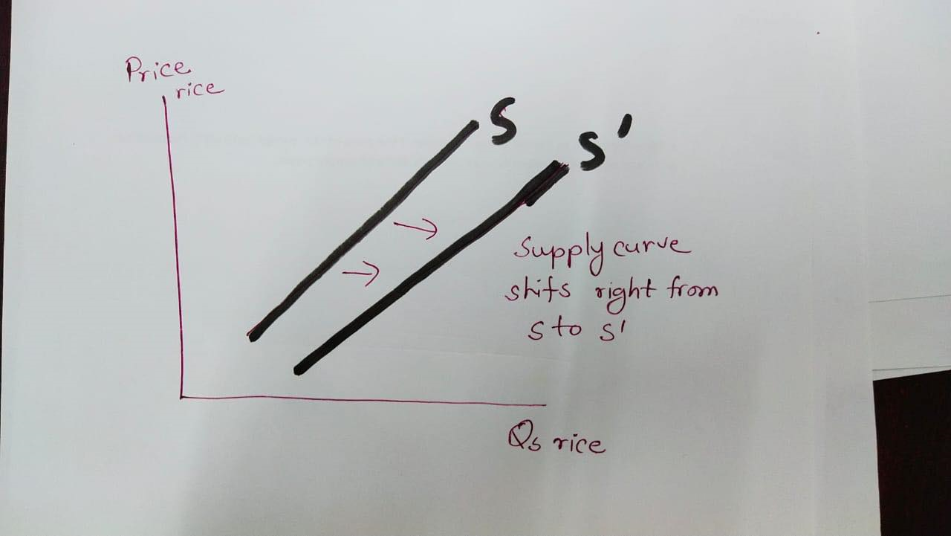
Shift of supply: Technology has been upgraded and supply of rice in rice market

Slide 12
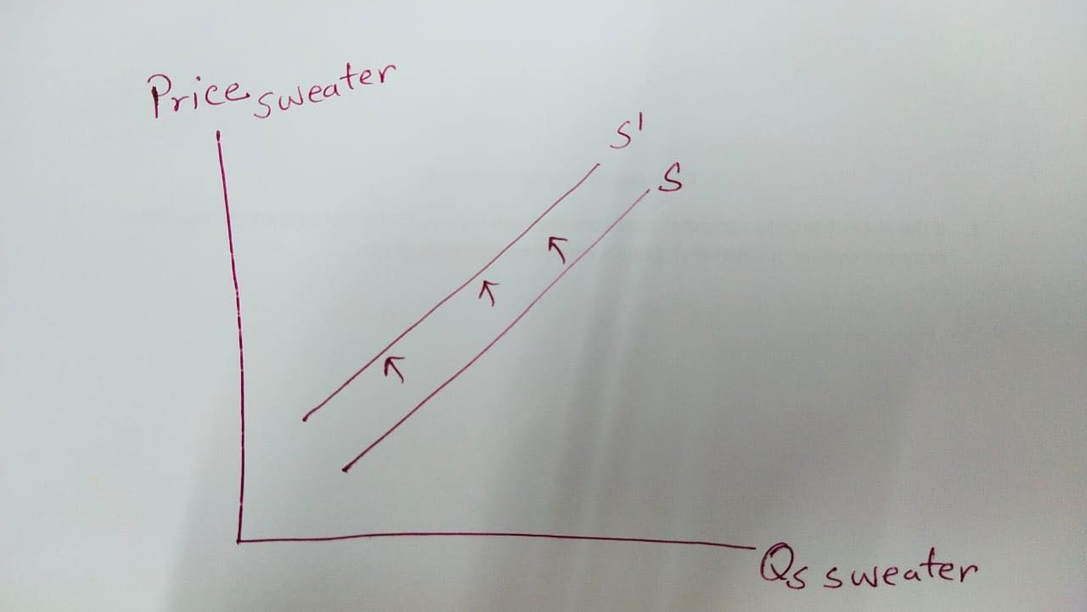
Shift of supply: Next month is December and sellers expect higher price of sweater in December. What will happen to currend supply for sweater market?

Slide 13
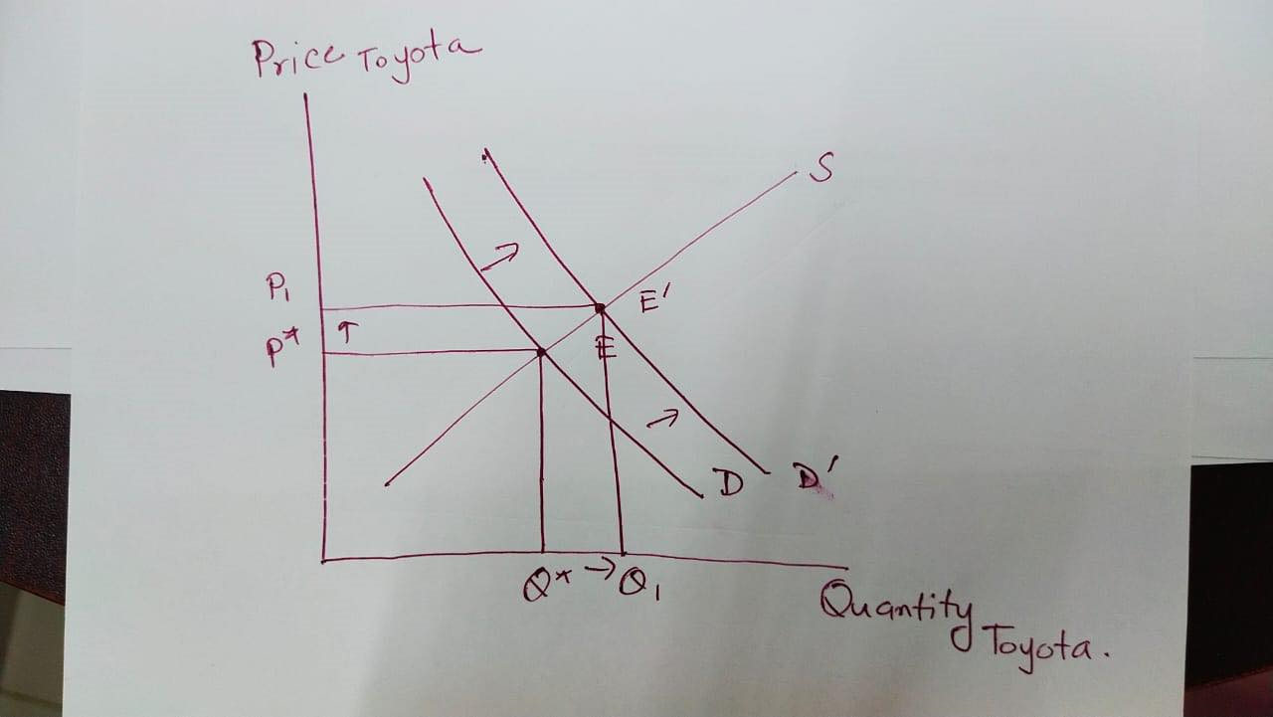
Change in Equilibrium: Suppose Toyota is inferior good and income falls for a Toyota buyer. What will happen to equilibrium price and equilibrium quantity in Toyota market?

Slide 14
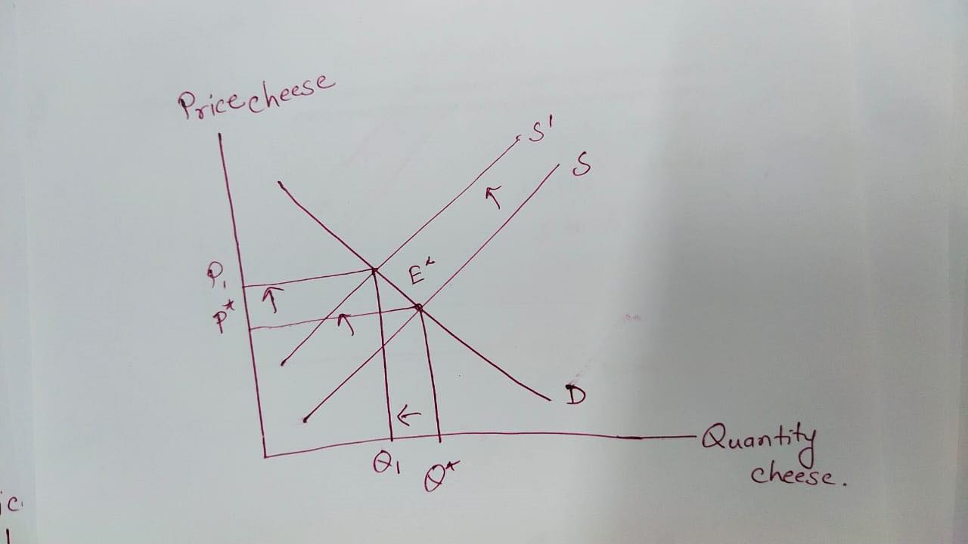
Change in Equilibrium: Suppose price of milk increases. What will happen to equilibrium price and equilibrium quantity in cheese market?

